Slide 1

DevOps & Cloud Infrastructure SEIS 665 Week 9
Jason Baker
Adjunct Instructor
Graduate Programs in Software
University of St. Thomas
St. Paul, MN

Slide 2
Agenda
Traditional vs. Modern DevOps IT
Infrastructure as Code
Dynamic infrastructure platforms
Infrastructure Definition Tools
AWS CloudFormation

Slide 3

Traditional IT

Slide 4
Traditional IT
Hand-built infrastructure based on physical hardware and guided by experience.
Every infrastructure component is unique and special.
Built at different times with slightly different processes.
Built by different people with different levels of experience.
“Just make it work.”
Infrastructure is rarely replaced and is fanatically supported throughout its lifecycle.
Infrastructure changes are carefully controlled by a Change Advisory Board (CAB).

Slide 5
Traditional IT
Role of IT infrastructure staff:
Gatekeepers for all IT services in the organization
“The Office of No.”
Often partitioned into specialist teams:
Network engineers
Storage engineers
Security analysts
DBAs
Architects focused on the big picture.
Team focused on preventing infrastructure failure.

Slide 6

Modern DevOps IT

Slide 7
Modern DevOps IT
Automated infrastructure that is repeatable and testable.
Elimination of snowflakes – unique infrastructure components.
Infrastructure is constantly being replaced.
Infrastructure changes are automated by a change management pipeline.

Slide 8
Infrastructure as Code
An approach to infrastructure automation based on practices from software development.
Version control systems
Automated code testing
Continuous integration
Infrastructure as Code goals:
IT supports change rather than being an obstacle.
Infrastructure changes become routine.
IT staff focus on valuable activities versus repetitive ones.
Users can self-provision IT services versus needing IT staff to help them.
IT teams focus on quickly recovering from failures versus trying to prevent them.

Slide 9
Dynamic Infrastructure Challenges
Server sprawl
It’s really easy to provision new servers.
It becomes difficult to patch and consistently maintain servers and the numbers grow.
Configuration drift
Configuration of servers gradually change over time.
Unmanaged variation leads to support and maintenance challenges.
Snowflake servers
Unique servers that cannot be easily replicated.
Leads to fragile infrastructure and components that nobody knows how to fix.
Automation fear
Fear of running automation tools because so much infrastructure is hand-cranked.
Erosion
Natural entropy suggests that problems will creep into systems over time.

Slide 10

Infrastructure as Code Principles
Systems can be easily reproduced like software builds
Systems are disposable
Treat your servers like cattle, not pets.
Systems are consistent
Infrastructure will always need to change
We use infrastructure definition and server configuration management tools to support these principles.
AWS Cloudstack, Openstack
Chef, Puppet, Ansible

Slide 11
Infrastructure as Code Practices
Use definition files
Specify infrastructure elements and how they are configured
JSON, YAML, XML or Domain Specific Language (DSL)
Self-documented systems
It’s difficult to document how to build infrastructure.
Definition files and scripts offer a testable form of documentation.
Version everything
Source of truth for the desired state of infrastructure.
Traceability: history of changes and who made them.
Rollback: ability to revert infrastructure to a previous state.
Visibility: infrastructure configuration is clearly visible to everyone.
Continuously test systems
Automated infrastructure testing: every infrastructure change goes through a testing process.

Slide 12
Anti-Fragility
IT has always been focused on building reliable infrastructure.
Infrastructure as Code goes beyond traditional IT and makes infrastructure anti-fragile.
Exercise damages muscles, but also makes them stronger.
Preventing change in IT systems makes them weaker, while increasing and managing change makes them stronger.
Netflix Chaos Monkey & Chaos Gorilla

Slide 13
Building Infrastructure as Code
We need three capabilities to build and maintain dynamic infrastructure:
A dynamic infrastructure platform
Provides an environment in which to dynamically build infrastructure components.
Infrastructure definition tools
Provides a way to describe how to build components in the dynamic infrastructure platform.
Configuration management tools
Provides a way to manage the configuration of infrastructure components over time.

Slide 14
Dynamic Infrastructure Platform
A system that provides servers, storage, and networking infrastructure in a programmatic way.
Amazon Web Services
Microsoft Azure
Google Compute Engine
OpenStack
VMware vCloud
Requirements:
Access to an API
On-demand: create and destroy resources immediately
Shouldn’t require requests to a provider to provision infrastructure
Anti-pattern: Hand-cranked clouds

Slide 15
Infrastructure Definition Tools
Tool that allows people to specify what infrastructure component to create and how to configure it.
Leverages the API provided by the dynamic infrastructure platform to create the component.
Examples:
AWS Cloud Formation
Terraform
Openstack Heat

Slide 16
Infrastructure Definition Tool Characteristics
Idempotent: execute the same script multiple times without negatively impacting infrastructure.
Pre/post-checks: ability for tool to validate starting conditions and check for successful completion.
Visible failure: shouldn’t hide provisioning failures.
Parameterized: allows the reuse of infrastructure definitions for multiple use-cases (i.e., environments).

Slide 17
Using Infrastructure Definition Tools
Common practices:
Unattended execution: definition tools do not require human intervention to build infrastructure.
Configuration definition files: infrastructure definitions are stored in text files (JSON, YAML, DSL, etc.)
Externalized configuration: code that defines infrastructure is located outside the tool versus some sort of hidden internal configuration file.
VCS: infrastructure definition files are stored in version control systems

Slide 18
Configuration Definition Files
Two ways to define infrastructure in configuration files:
Procedurally: describe the step-by-step process required to build infrastructure
“First do X, then do Y.”
Example: Shell script or application library using AWS API to create infrastructure.
Declaratively: describe what the infrastructure should look like and let a tool build it.
“It should be Z.”
Sometimes called policy-based configuration.
Benefit: typically run idempotently – can apply configuration over-and-over again

Slide 19
Procedural vs. Declarative

Slide 20

AWS CloudFormation
AWS infrastructure definition tool used for automating the deployment of cloud infrastructure
Several AWS services (Elastic Beanstalk, ECS, etc.) use CloudFormation for infrastructure provisioning
CloudFormation uses a template to describe what resources to configure on AWS
Template is written in JSON format
Supports good Infrastructure as Code practices
Store in version control
Ability to test
Repeatable
A set of configured cloud resources is called a stack.

Slide 21
CloudFormation
Common use-cases include:
Creating multiple environments for application development, staging, and production
Templates support parameters to allow for reuse in different situations
Deploying stacks of cloud resources in different regions
Blue/green deployments
Disaster Recovery

Slide 22
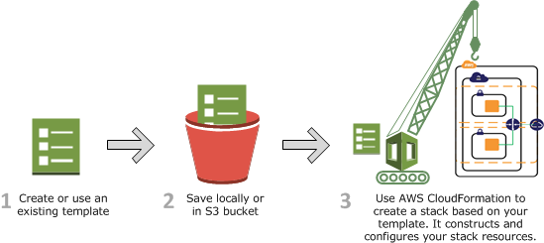
How CloudFormation Works
CloudFormation uses template definition to make API calls to AWS
User’s permissions determines what resources it can create.
Process:
1. Create a CloudFormation Template (JSON) in CloudFormation Designer or a text editor.
2. Save the template locally or in an S3 bucket.
3. Create a stack by specifying the template and providing any required input parameters using console, API, or CLI.
4. CloudFormation provisions resources and reports back when the stack is created.

Slide 23
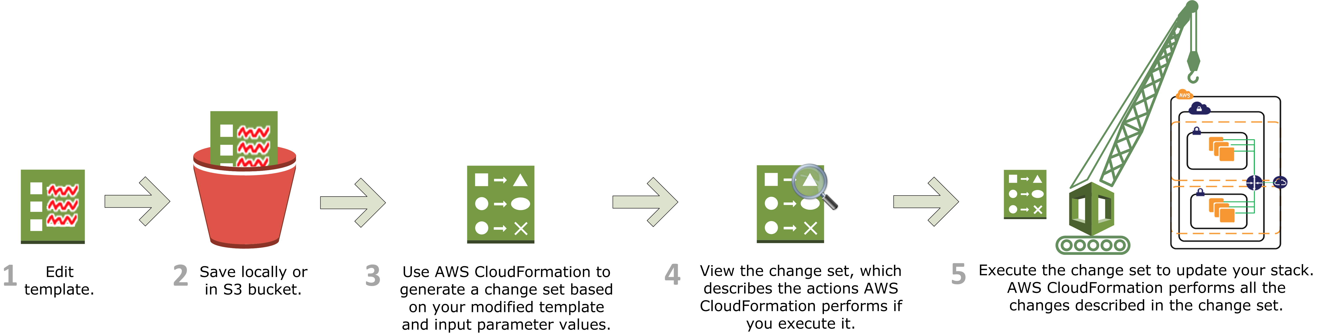
Updating a stack
Update stacks by submitting a modified version of the original stack template or by providing new input parameters.
CloudFormation compares the original and modified template and generates a change set.
After reviewing the changes, you can execute the change set to update the stack.
Note: the update may disrupt stack services because some may be replace.

Slide 24
Stack Policies
Sometimes you may not want to update all the resources in a stack during stack updates.
Use stack policies to protect resources.
Creating a stack policy protects all resources by default so you have to specify what types of updates are allowed.
Example: preventing the update or replacement of a production database instance.
{
"Statement" : [
{
"Effect" : "Allow",
"Action" : "Update:*",
"Principal": "*",
"Resource" : "*"
},
{
"Effect" : "Deny",
"Action" : "Update:*",
"Principal": "*",
"Resource" : "LogicalResourceId/ProductionDatabase"
}
]
}

Slide 25
CloudFormation Template
{
“AWSTemplateFormationVersion” : “version date”,
“Description” : “JSON string”,
“Metadata” : {
template metadata
},
“Parameters” : {
set of parameters
},
“Mappings” : {
set of mappings
},
“Conditions” : {
set of conditions
},
“Resources” : {
set of resources
},
“Outputs” : {
set of outputs
}
}

Slide 26
Intrinsic Functions
CloudFormation supports several built-in functions to help you build stacks.
Only usable in certain parts of the template – mainly in resource properties.
"Properties" : {
"MyMyLBDNSName" : {
"Fn::GetAtt" : [ "MyLoadBalancer", "DNSName" ]
}
}

Slide 27
Intrinsic Functions
Fn::Base64
Returns the Base64 representation of a string.
Typically used for passing userdata to an EC2 instance.
{ “Fn::Base64” : “SEIS 665” }
Fn:FindInMap
Returns the value corresponding to keys in a map
"Fn::FindInMap" : [ "MapName", "TopLevelKey", "SecondLevelKey"]
Fn:GetAtt
Returns the value of an attribute from a resource in the template.
"Fn::GetAtt" : [ "MyLB" , "DNSName" ]
Fn:GetAZs
Returns an array that lists Availability Zones for a specified region.
{ "Fn::GetAZs" : { "Ref" : "AWS::Region" } }

Slide 28
Intrinsic Functions
Fn:Join
Appends a set of values into a single value with an optional delimiter.
"Fn::Join" : [ ":", [ "a", "b", "c" ] ]
Returns: “a:b:c”
Fn:Select
Returns a single object from a list of objects.
{ "Fn::Select" : [ "1", [ "apples", "grapes", "oranges", "mangoes" ] ] }
Returns: “grapes”
Ref
Returns the value of the specified parameter or resource.
"Ref" : "logicalName”
Condition Functions
Used within conditions sections to conditionally create resources.
"Fn::Equals" : ["value_1", "value_2"]
"Fn::If": [condition_name, value_if_true, value_if_false]
"Fn::And": [{condition}, {...}]
"Fn::Or": [{condition}, {...}]
"Fn::Not": [{condition}]

Slide 29
Format Version & Description sections
The optional AWSTemplateFormatVersion section specifies the template version to use.
Defaults to “2010-09-09” version.
"AWSTemplateFormatVersion" : "2010-09-09”
The optional Description section includes arbitrary comments about the template.
Must follow the AWSTemplateFormatVersion section
Literal string of 0-1024 characters
"Description" : "Here are some details about the template."

Slide 30
Metadata section
The optional Metadata section includes arbitrary JSON objects that provide details about the template.
Useful for documentation/ comments
A few special metadata parameters affect other CloudFormation features:
AWS::CloudFormation::Init, AWS::CloudFormation::Interface
"Metadata" : {
"Instances" : {"Description" : "Information about the instances"},
"Databases" : {"Description" : "Information about the databases"}
}

Slide 31
Parameters section
Templates allow the user to supply input parameters when launching a stack.
Parameter logical names must be unique
Logical name definition followed by a series of parameter properties
Types: String, Number, List, or AWS-specific type
Maximum of 60 parameters allowed in a template
Input parameters are referenced within a template using the “Ref” function.
"Parameters" : {
"ParameterLogicalID" : {
"Type" : "DataType",
"ParameterProperty" : "value“
}
}

Slide 32
Parameters section
Useful properties (not a complete list):
AllowedValues: an array containing list of values allowed for the parameter.
Default: the value used for the property if no value is specified.
Description: a string describing the parameter.
MaxLength/MinLength/MaxValue/MinValue: set a constraint on the input value
NoEcho: hide the parameter value in any output logs (useful for passwords)

Slide 33
Parameters section
“Parameters” {
“InstanceTypeParameter” : {
“Type” : “String”,
“Default” : “t2.micro”,
“AllowedValues” : [“t2.micro”, “t2.small”, “t2.medium”},
“Description” : “Enter the instance type (t2.micro, t2.small, or t2.medium).”
}
}
“Ec2Instance” : {
“Type” : “AWS::EC2::Instance”,
“Properties” : {
“InstanceType” : { “Ref” : “InstanceTypeParameter” },
“ImageId” : “ami-398de234”
}
}

Slide 34
Pseudo Parameters
Pseudo Parameters are predefined parameters provided by CloudFormation.
Use them the same way as normal parameters.
List of pseudo parameters:
AWS::AccountId
returns AWS account ID in which stack is created
AWS::NotificationARNs
returns list of AWS Resource Names for stack
AWS::NoValue
acts like a NOOP and removes the property identifier
AWS::Region
returns a string representing the AWS region for the stack
AWS::StackId
returns ID of the stack
AWS:StackName
returns the name of the stack

Slide 35
Mappings section
Template mappings allow the user to define keys that map to corresponding sets of named values.
Commonly used for setting values based on different conditions, such as regions.
Example: Set a value to an AMI ID based on the region the stack is launching into.
The “FindInMap” function is used in the template to find a matching value based on a key.
"Mappings" : {
"Mapping01" : {
"Key01" : {
"Name" : "Value01“
},
"Key02" : {
"Name" : "Value02“
},
}
}

Slide 36
Mappings section
"Mappings" : {
"RegionMap" : {
"us-east-1" : { "32" : "ami-6411e20d", "64" : "ami-7a11e213" },
"us-west-1" : { "32" : "ami-c9c7978c", "64" : "ami-cfc7978a" },
"eu-west-1" : { "32" : "ami-37c2f643", "64" : "ami-31c2f645" },
"ap-southeast-1" : { "32" : "ami-66f28c34", "64" : "ami-60f28c32" },
"ap-northeast-1" : { "32" : "ami-9c03a89d", "64" : "ami-a003a8a1" }
}
},
"Resources" : {
"myEC2Instance" : {
"Type" : "AWS::EC2::Instance",
"Properties" : {
"ImageId" : { "Fn::FindInMap" : [ "RegionMap", { "Ref" : "AWS::Region" }, "32"]},
"InstanceType" : "m1.small"
}
}
}
If AWS::Region is us-east-1, ImageId is set to ami-6411e20d.

Slide 37
Conditions section
Template conditions control the creation of resources or the definition of properties
Conditions are defined by the template author and applied to resources.
A condition must evaluate to true in order for the resources to get built.

Slide 38
Conditions section
“Parameters” : {
“EnvType” : {
“Description” : “Environment type.”,
“Default” : “dev”,
“Type” : “String”,
“AllowedValues” : [“prod”, “dev”],
“ConstraintDescription” : “Must specify prod or dev.”
}
},
“Conditions” : {
“CreateProdResources” : {“Fn::Equals” : [{“Ref” : “EnvType”}, “prod”]}
},
“MountPoint” : {
“Type” : “AWS::EC2:VolumeAttachment”,
“Condition” : “CreateProdResources”,
“Properties” : {
“InstanceId” : { “Ref” : “EC2Instance” },
“VolumeId” : { “Ref” : “NewVolume” },
“Device” : “/dev/sdh”
}
}

Slide 39
Resources section
Required section that describes the AWS resource to be built in the stack.
IAM policies, VPCs, Subnets, Security Groups, EC2 instances, Elastic Load Balancers, RDS databases, S3 buckets, etc.
"Resources" : {
"Logical ID" : {
"Type" : "Resource type",
"Properties" : {
Set of properties
}
}
}
DependsOn attribute allows you to specify that a resource must wait for CloudFormation to create another resource first.
"DependsOn" : [ String, ... ]

Slide 40
Resources section
Multiple ways to define properties:
"Properties" : {
"String" : "one-string-value",
"Number" : "123",
"LiteralList" : [ "first-value", "second-value" ],
"Boolean" : "true",
"ReferenceForOneValue" : { "Ref" : "MyLogicalResourceName" } ,
"FunctionResultWithFunctionParams" : {
"Fn::Join" : [ "%", [ "Key=", { "Ref" : "MyParameter" } ] ] }
}

Slide 41
Resources section
"Resources" : {
"MyInstance" : {
"Type" : "AWS::EC2::Instance",
"Properties" : {
"UserData" : {
"Fn::Base64" : {
"Fn::Join" : [ "", [ "Queue=", { "Ref" : "MyQueue" } ] ]
} },
"AvailabilityZone" : "us-east-1a",
"ImageId" : "ami-20b65349"
}
},
"MyQueue" : {
"Type" : "AWS::SQS::Queue",
"Properties" : {
}
}
}

Slide 42
Outputs section
The optional outputs section declares values that CloudFormation will return when the stack is created.
Example: return the name of an S3 bucket after CloudFormation creates it
Maximum of 60 outputs allowed in a template
Value of an output can be a literal, parameter reference, pseudo parameter, mapping value, or intrinsic function
It’s possible to set a condition on the output using the “Condition” parameter
"Outputs" : {
"Logical ID" : {
"Description" : "Information about the value",
"Value" : "Value to return"
}
}

Slide 43
Outputs section
"Outputs" : {
"BackupLoadBalancerDNSName" : {
"Description": "The DNSName of the backup load balancer",
"Value" : { "Fn::GetAtt" : [ "BackupLoadBalancer", "DNSName" ]},
"Condition" : "CreateProdResources"
},
"InstanceID" : {
"Description": "The Instance ID",
"Value" : { "Ref" : "EC2Instance" }
}
}

Slide 44
Nested Stacks
CloudFormation stacks can be used as resources in other stacks.
Useful for making reusable templates and segmenting resources.
Launching a template with nested stacks will launch multiple sub-stacks.
Nested stack templates must be stored in an S3 bucket.
Deleting launching stack will delete all substacks.

Slide 45
Nested Stacks
Nested Stack definition properties:
Parameters: define set of parameters passed to nested stack.
TemplateURL: S3 bucket location for the nested stack.
TimeoutInMinutes: length of time CloudFormation waits for the nested stack to complete (default is no timeout).
{
"Type" : "AWS::CloudFormation::Stack",
"Properties" : {
"NotificationARNs" : [ String, ... ],
"Parameters" : { CloudFormation Stack Parameters Property Type },
"Tags" : [ Resource Tag, ... ],
"TemplateURL" : String,
"TimeoutInMinutes" : String
}
}

Slide 46
CloudFormation Best Practices
Don’t build a template from scratch.
Read sample templates or use AWS CloudFormation Designer as a starting point.
Reuse templates as much as possible.
Don’t nest stacks more than one level.
Use parameters to set the environment, region, instance names & sizes, etc.
Remember to add tags to all resources.
Consider using a snapshot to backup resources that may be changed during a stack update.
Example: changing engine type of an RDS instance.
Alternatively: set a stack policy to protect resources from updates.

Slide 47
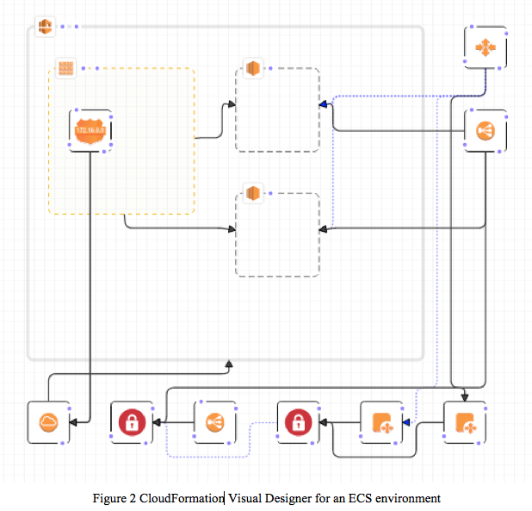
CloudFormation Designer
A graphical tool to visualize and edit CloudFormation templates.
Easy way to start new designs or edit specific resources in complex templates.
JSON template editor supports auto-complete using Ctrl-Space.

Slide 48

CloudFormation Hands-on
Create a simple stack with an EC2 instance and security group
Setup EC2AvailabilityZone input parameter:
Add EC2 Instance and rename to “MyFirstInstance”
Add SecurityGroup and rename to “Webservers”
Connect instance to security group
Save template to local disk, validate template, and launch.
Go back to CloudFormation stacks and update stack with new AZ.
Delete the stack
{
"Parameters": {
"EC2AvailabilityZone": {
"Description": "Select an availability zone.",
"Type": "AWS::EC2::AvailabilityZone::Name"
}
}
}

Slide 49
CloudFormation Hands-on
….
"Type": "AWS::EC2::Instance",
"Properties": {
"AvailabilityZone": {
"Ref": "EC2AvailabilityZone"
},
"InstanceType": "t2.micro",
"ImageId": "ami-6869aa05",
"KeyName": "seis665",
….
….
"Type": "AWS::EC2::SecurityGroup",
"Properties": {
"GroupDescription": "Allow incoming web requests.",
"SecurityGroupIngress": [
{
"FromPort": "80",
"ToPort": "80",
"IpProtocol": "tcp",
"CidrIp": "0.0.0.0/0"
},
{
"FromPort": "22",
"ToPort": "22",
"IpProtocol": "tcp",
"CidrIp": "0.0.0.0/0"
}
]
}
….

Slide 50
Additional Resources
AWS re:Invent 2015 (DVO304) CloudFormation Best Practices presentation
https://youtu.be/fVMlxJJNmyA
CloudFormation documentation
https://www.amazon.com/en/documentation/cloudformation/

Slide 51
Homework
Assignment 8
Read Infrastructure as Code Chapters 7 & 8

